Slide 1

Apache Spark Fundamentals
Getting Started
Justin Pihony
@JustinPihony | justin-pihony.blogspot.com
Notes:
NEXT: Spark and Me

Slide 2



Me and Spark
Apache Spark Fundamentals
https://www.surveymonkey.com/r/B27PKZZ
Notes:
Pluralsight
StackOverflow
Typesafe
(Holden book, 100’s hours videos)
Survey
NEXT: Why Spark

Slide 3







Why?
grep?
Notes:
Grep – single machine – Snail
Hadoop – Distributed many machines – Puma
Spark – Distributed less machines – Roadster
NEXT: Record Setting

Slide 4
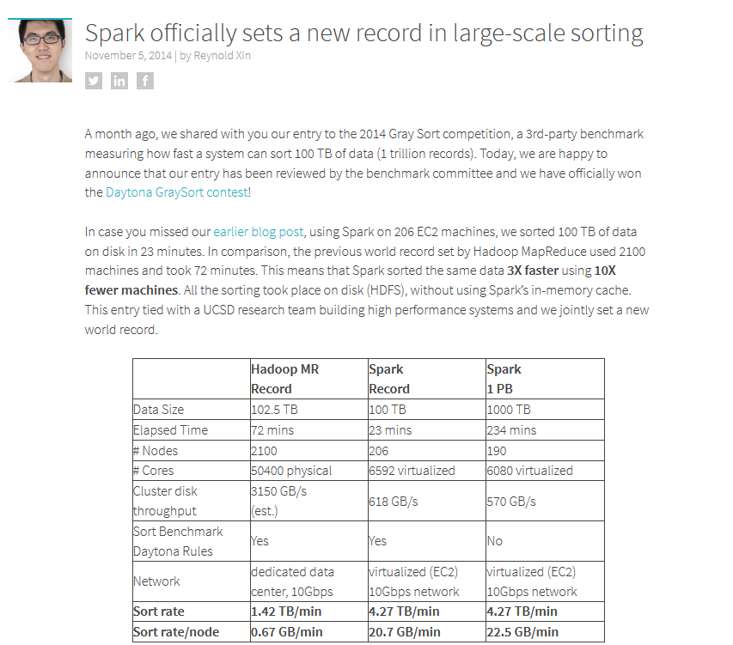
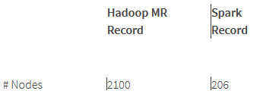
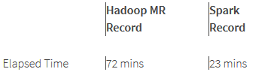

http://databricks.com/blog/2014/11/05/
spark-officially-sets-a-new-record-in-large-scale-sorting.html
Notes:
2014; Fuxisort 2015…but used 17x more processors
3x faster
10x fewer machines
Constant sort rate – Up to a pedabyte
NEXT: Speed isn’t only thing improved, code size also

Slide 5
Big Data
Notes:
NEXT: Hadoop Big Code

Slide 6
Big Data
Big Code
public class WordCount {
public static class Map extends Mapper<LongWritable, Text, Text, IntWritable> {
private final static IntWritable one = new IntWritable(1);
private Text word = new Text();
public void map(LongWritable key, Text value, Context context) throws IOException, InterruptedException {
String line = value.toString();
StringTokenizer tokenizer = new StringTokenizer(line);
while (tokenizer.hasMoreTokens()) {
word.set(tokenizer.nextToken());
context.write(word, one);
}
}
}
public static class Reduce extends Reducer<Text, IntWritable, Text, IntWritable> {
public void reduce(Text key, Iterable<IntWritable> values, Context context)
throws IOException, InterruptedException {
int sum = 0;
for (IntWritable val : values) {
sum += val.get();
}
context.write(key, new IntWritable(sum));
}
}
public static void main(String[] args) throws Exception {
Configuration conf = new Configuration();
Job job = new Job(conf, "wordcount");
job.setOutputKeyClass(Text.class);
job.setOutputValueClass(IntWritable.class);
job.setMapperClass(Map.class);
job.setReducerClass(Reduce.class);
job.setInputFormatClass(TextInputFormat.class);
job.setOutputFormatClass(TextOutputFormat.class);
FileInputFormat.addInputPath(job, new Path(args[0]));
FileOutputFormat.setOutputPath(job, new Path(args[1]));
job.waitForCompletion(true);
}
}
Notes:
X
NEXT: Tiny code

Slide 7
Big Data
Big Code
Tiny Code
public class WordCount {
public static class Map extends Mapper<LongWritable, Text, Text, IntWritable> {
private final static IntWritable one = new IntWritable(1);
private Text word = new Text();
public void map(LongWritable key, Text value, Context context) throws IOException, InterruptedException {
String line = value.toString();
StringTokenizer tokenizer = new StringTokenizer(line);
while (tokenizer.hasMoreTokens()) {
word.set(tokenizer.nextToken());
context.write(word, one);
}
}
}
public static class Reduce extends Reducer<Text, IntWritable, Text, IntWritable> {
public void reduce(Text key, Iterable<IntWritable> values, Context context)
throws IOException, InterruptedException {
int sum = 0;
for (IntWritable val : values) {
sum += val.get();
}
context.write(key, new IntWritable(sum));
}
}
public static void main(String[] args) throws Exception {
Configuration conf = new Configuration();
Job job = new Job(conf, "wordcount");
job.setOutputKeyClass(Text.class);
job.setOutputValueClass(IntWritable.class);
job.setMapperClass(Map.class);
job.setReducerClass(Reduce.class);
job.setInputFormatClass(TextInputFormat.class);
job.setOutputFormatClass(TextOutputFormat.class);
FileInputFormat.addInputPath(job, new Path(args[0]));
FileOutputFormat.setOutputPath(job, new Path(args[1]));
job.waitForCompletion(true);
}
}
object WordCount{
def main(def main(args: Array[String])){
val sparkConf = new SparkConf()
.setAppName("wordcount")
val sc = new SparkContext(sparkConf)
sc.textFile(args(0))
.flatMap(_.split(" "))
.countByValue
.saveAsTextFile(args(1))
}
}
Notes:
Scala guts
Hadoop Here – Here – Here
NEXT: Fuller Why Spark

Slide 8

Why Spark?
Readability
Expressiveness
Fast
Testability
Interactive
Fault Tolerant
Unify Big Data
Notes:
Readability
Expressiveness
Fast
Testable
Interactive
Fault Tolerant
Unification
NEXT: Agenda

Slide 9
Agenda
Basics of Spark
Core API
Cluster Managers
Spark Maintenance
Libraries
SQL
Streaming
MLlib/GraphX
Troubleshooting / Optimization
Future of Spark
Notes:
Basics of Spark
Core API
Cluster Managers (At end actually, if time)
Spark Maintenance
Libraries – SQL – Streaming – Mllib/GraphX
Troubleshooting/Optimization
Future of Spark
Basics is first focus
NEXT: Basics – Hadoop (MR Explosion)

Slide 10

The MapReduce Explosion
Notes:
MR Explosion
NEXT: Elephant Slide for MR

Slide 11









Notes:
Storm (Streaming)
Scalding (Scala DSL)
Hive (SQL)
REST (Mahout Giraph)
All can be done with Spark
NEXT: What does this mean?

Slide 12

Notes:
NEXT: Spark is a Unified Platform for Big Data

Slide 13
A Unified Platform for Big Data
DataFrames
Spark
SQL
Spark
Streaming
MLlib
(machine
learning)
GraphX
(graph)
Spark Core
Notes:
Spark Core is its roots
SQL – Streaming – Mllib – GraphX
DataFrames
NEXT: Abstractions FTW

Slide 14
Abstractions FTW
GraphX
Streaming
SQL
Core
Hadoop
MR
Impala
Storm
Giraph
Spark
*As of April 2015 using cloc w/o tests or examples
Notes:
LOC
MR
Impala (SQL)
Storm
Giraph
Spark Core – SQL – Streaming – GraphX
NEXT: Spark History

Slide 15


The History of Spark
BSD Open Source
Spark Paper
Apache
Top Level
MapReduce
databricks
2004
2006
2009
2010
2011
2013
2014
Notes:
MR Paper 2004
Hadoop at Yahoo 2006
Spark 2009
Spark Paper 2010 – Open Sourced under BSD
2011 amplab – amp (alg/machines/people)
2013 databricks founded – Apache-ized
2014 Top Level
Future is bright (DataFrames/Massive Adoption/Continuous Improvements/NEXT)
NEXT: Databricks

Slide 16

databricks ==
STABILITY
Notes:
NEXT: Stability is important

Slide 17
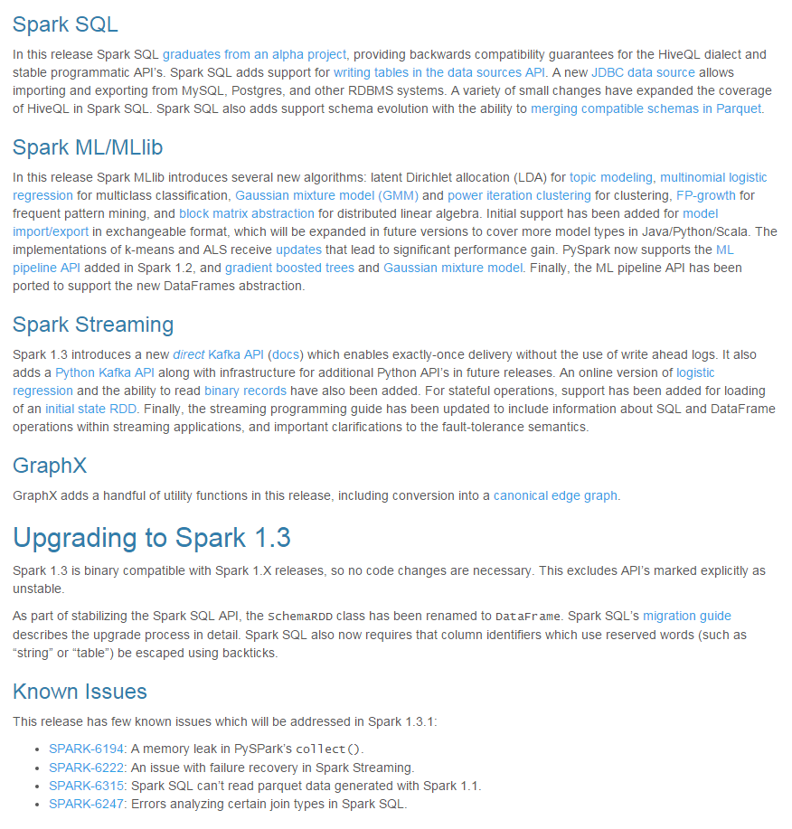
Stability
https://spark.apache.org/releases/spark-release-MAJOR-MINOR-REVISION.html
Notes:
Binary Compatibility is the goal amongst major releases
Backwards compatibility even for alpha
NEXT: Custom build breaks if compatibility is broken

Slide 18
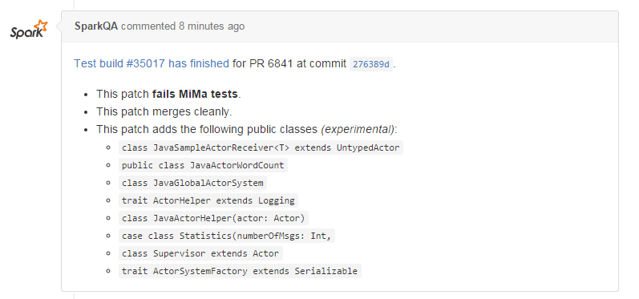
Stability
https://github.com/apache/spark/pull/6841
Notes:
(Also shows new public APIs)
NEXT: Time over features

Slide 19

Stability
Notes:
(3 months)
NEXT: Who’s using

Slide 20









Who Is Using Spark?
Yahoo!
Notes:
Pandora (realtime recommendations) – Yahoo – Comcast – Ooyala – Conviva – Netflix
Realtime fraud threat analytics
Log Agg and Analysis eBay
Twitter graph analysis social networks
Science exploration (Freemand Lab at Janelia; analyzing/visualizing brain activity realtime; Cure cancer or more?)
NEXT: Install and code

Slide 21
Enough talk!
Let’s try it out!
Notes:
NEXT: Spark Languages

Slide 22



Spark Languages
Notes:
(So, is Scala your only choice? More than one at your disposal)
Written in scala
Means Java API
Also Python API (sometimes lagging)
NEXT: Recently added R

Slide 23

Spark Languages
Notes:
(Covers the big data language spectrum)
NEXT: Projects

Slide 24

Projects
#
Notes:
Wiki Data Analysis
Twitter Streaming
NEXT: Before diving into core, what is Big Data?

Slide 25

Big Data
Notes:
IOT means that data comes from anywhere
NEXT: But don’t use the wrong tool

Slide 26

Big Data
Notes:
(Sometimes grep IS the right tool…using Spark for small data is like smashing nut with a sledge)
NEXT: So, just use the right tool

Slide 27
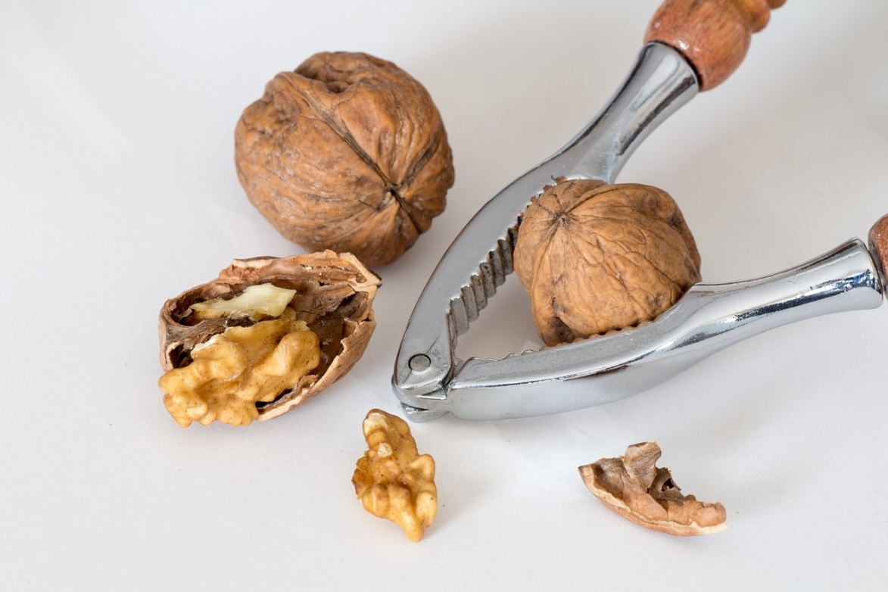
Big Data
Notes:
(Use your own discretion and testing)
NEXT: Resources for this choice making

Slide 28
Resources
https://www.chrisstucchio.com/blog/2013/hadoop_hatred.html
http://aadrake.com/command-line-tools-can-be-235x-faster-than-your-hadoop-cluster.html
http://blog.quantifind.com/posts/spark-unit-test/
Notes:
Two articles on choosing the right tool
Unit test is not the focus, but here’s an interesting read, otherwise it’s just like any other
NEXT: Resources for Basics

Slide 29
Resources
https://spark.apache.org
/documentation.html
/docs/latest/
/community.html
/examples.html
Learning Spark: Lightning-Fast Big Data Analysis by Holden Karau, Andy Konwinski, Patrick Wendell, Matei Zaharia
https://www.typesafe.com/activator/templates#filter:spark
https://github.com/apache/spark
Notes:
Spark website – documentation (resources) – component docs/API – Community events – Basic examples
Holden book
Activator templates
Github
NEXT: Summary

Slide 30
Summary
Why
MapReduce Explosion
Spark’s History
Installation
Hello Big Data!
Additional Resources
Notes:
(Questions on any of this?)

